Slide 1
Locality Sensitive Hashing
By: Karthik, Krishna Teja and Nikhil

Slide 2
Contents
Our question
LSH
Approach
Time complexity
Applications
Challenges

Slide 3
Our question
Implement a nearest neighbor search for any arbitrary point q ∈ {0,1}^d by choosing a hash function h from H(family of functions) uniformly at random, and returning the nearest neighbor of q from the bin (the set X ⊂ {0,1}^d with n points, i.e., X consists of n binary vectors in d-dimensions).
If X ⊂ R^d instead of binary vectors, what family of hash functions would you choose?

Slide 4
What is LSH?
It is a hashing technique that helps in nearest neighbour search queries.
If two points x , y were given and h(x)=h(y) then these two points are expected to neighbours and will be hashed to the same place in the table, in the case of LSH. ( h is one of the many hash-functions in the family H)
For our question we used the concepts of hamming distance and hyperplanes.

Slide 5
Approach
Our first step was to generate k-hyperplanes in a d-dimensional space, these k-hyperplanes divide the space into 2^k regions(which is also the size of the tables).
The points in the same region will be hashed into the same part of the hashtables.
There is still a chance that points, that are not considered to be neighbours, to be hashed into the compartment in the table. To avoid this, we consider multiple hash-functions and generate multiple hashtables.
For each hashfunction we use, one corresponding table is generated, so when the user asks for NN of a point, the code runs through each table to give us the nearest neighbour.

Slide 6
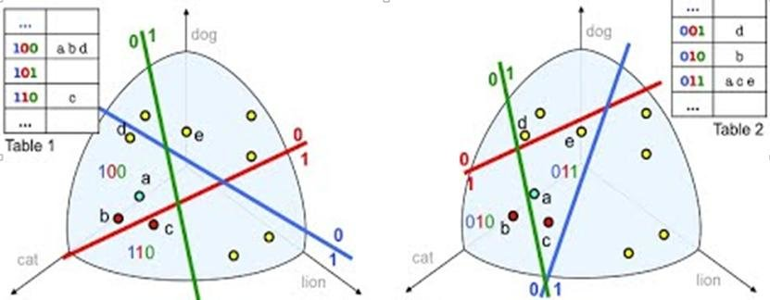
Cont.
When a hyperplane divides the space, each point is wrote as a binary string. This is done by first finding out on which side the points are wrt the plane.(done by using dot prod)
In this example the space is divide into 8 parts each represented by a 3-bit binary string.
Points in the same region will be chained at the index(= value of binary string).

Slide 7
Time Complexity
Lets say that the space is of d-dimension, where we divide it with k-hyperplanes each time we call a hashfunction and there are a total of n-points and L-hashtables(i.e L sets of hyperplanes).
While searching for NN of the given point from the user, we will use the hashfunctions for each table to get the hashindex and the linked list of potential NN of the given point. (i.e we get L linked lists).
Size of the table is 2^k and total points in n, so the mean size of the lists are n/(2^k).

Slide 8
Cont.
First we to get a list of NN from a hashtable, lets say from HTi we will use hashfunction hi to get the region/index of the point. This takes O(k*d) because dot product between the point and a plane is O(d). Since there are L tables this takes O(k*d*L).
Now that we got L lists, we calculate the hamming distance of our point from the points in the list and return the point which is closest. Time for calculating distance is O(d) and total points that we are checking the distance with is (n/(2^k))*L =>time = O(d*(n/2^k)*L)

Slide 9
Cont.
Total time = O(k*d*L) + O(n/2^k * L*d)
= O(log2(n) * d * L) since k = log2(n)
= O(log2(n) * d) since L is a const.
while brute force method is done in O(n*d).

Slide 10
Applications
Image/Audio similarity identification
Near-duplication detection
Nearest neighbor search
Audio fingerprint
Digital video fingerprinting

Slide 11
Challenges
Interpreting the question.
Generating hyperplanes

